Slide 1
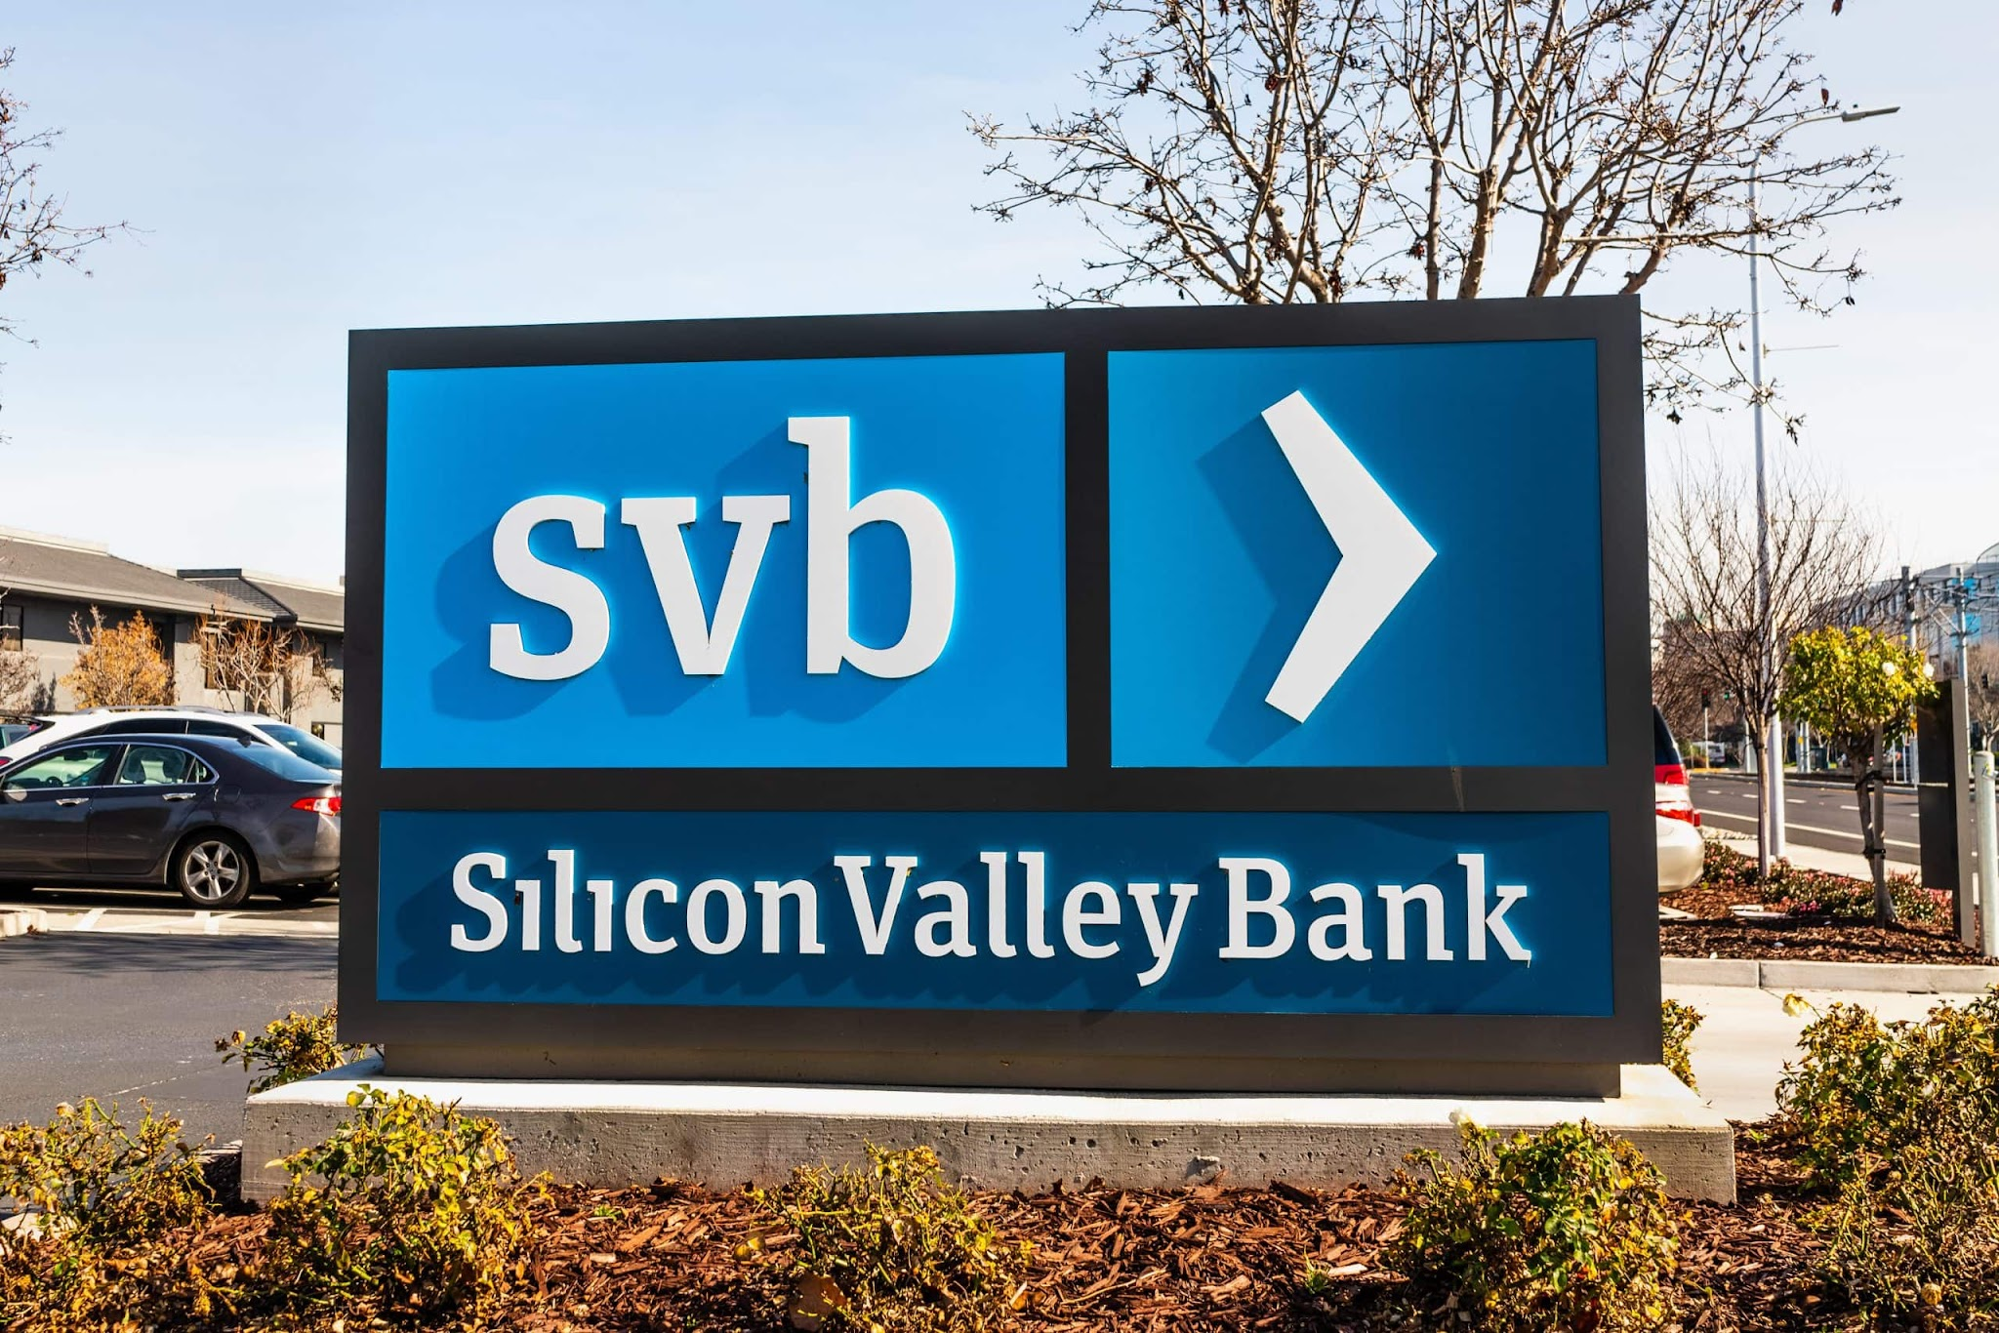
https://www.btc-echo.de/news/silicon-valley-bank-darum-ist-der-absturz-gefaehrlich-fuer-krypto-160810/

Slide 2
AGENT-BASED MODELING · SS 2026
Bank Run
Simulation
Agent-Based Contagion via Social Networks
Tim Haenicke & Moritz Graemer
Notes:
5-10 min what is the project about
10min what is the model (abstract, but percise) + show the program and the code (visualisierung mit blöcken)
present the model
preliminary results ~ 45min max 60min

Slide 3
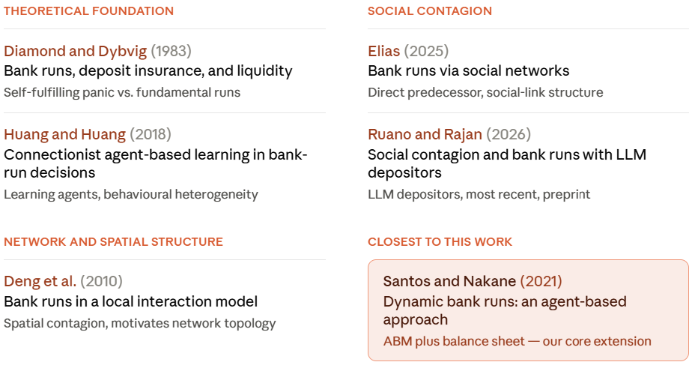
01 Motivation and Literature
Literature Review

Slide 4
Structure
01 Introduction
02 Research Question
03 Model Setup
04 Results
05 Sources

Slide 5
02 Research Question
Research Question
How does the connectedness of a network influence the impact of shocks on a bank's balance sheet?

Slide 6



03 MODELL-SETUP
The Story
bank
liquid
illiquid
signal(liquidity)
depositors
Sleeper
Watcher
n*(1-watcher_share)
n*watcher_share
Notes:
bank
Holds all deposits of agents
× % kept liquid as reserve ratio
(1-x) % locked in long-term assets
Solvency determined by banks behaviour
Collapses when liquidity < withdrawals
signal & agents
Exogenous noisy signal → Watchers
Watchers: receive external signal
Sleepers: only hear from neighbours
Insiders (20%): direct health access
Signals weighted by sender credibility
Withdrawal reduces bank liquidity

Slide 7
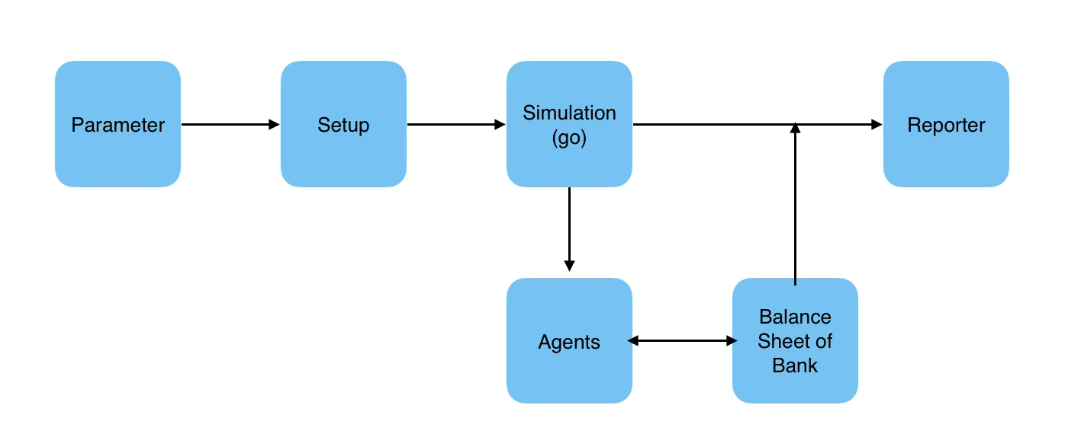
03 MODELL-SETUP
The Code

Slide 8
03 MODELL-SETUP
turtles-own [
state ;; "calm" | "concerned" | "withdraw"
watcher? ;; true = receives s(l)
credibility ;; [0,1] -> size / credibility
deposit-i ;; agents deposit in bank
cash-held ;; withdrawn money
naivety-concerned ;; lower threshold(calm -> concerned)
naivety-withdraw ;; upper threshold (concerned -> withdraw)
]

Slide 9
03 MODELL-SETUP
globals [
bank-deposits ;; deposits
bank-liquidity ;; liquidity
bank-debt ;; current bank debt
bank-alive? ;; banks state
current-signal ;; signal
initial-deposits ;; reference for lolr-cap
shocked? ;; for tracking simulation
shock-tick ;; -1 = no shock, after that counts ticks since shock
peak-withdrawn ;; max frac withdrawn
]

Slide 10
03 MODELL-SETUP
to go
if not bank-alive? [ stop ]
update-signal
baseline-noise
agents-decide
bank-manage-liquidity
recolor
tick
end

Slide 11
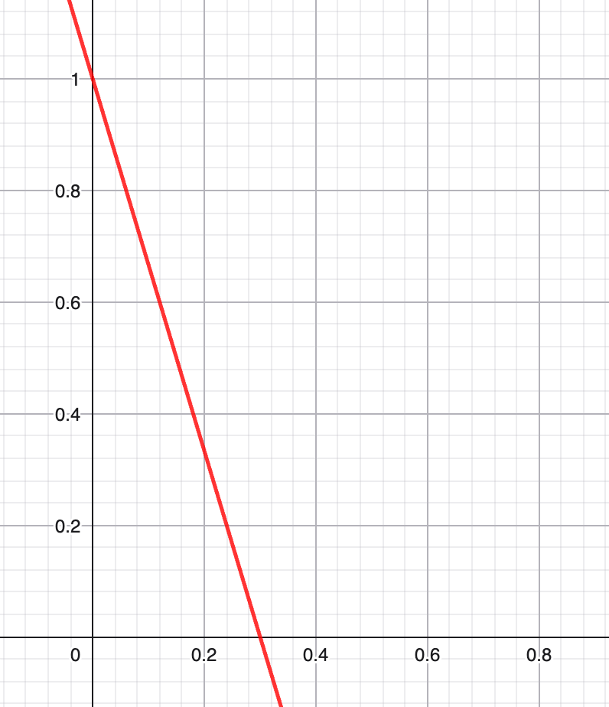
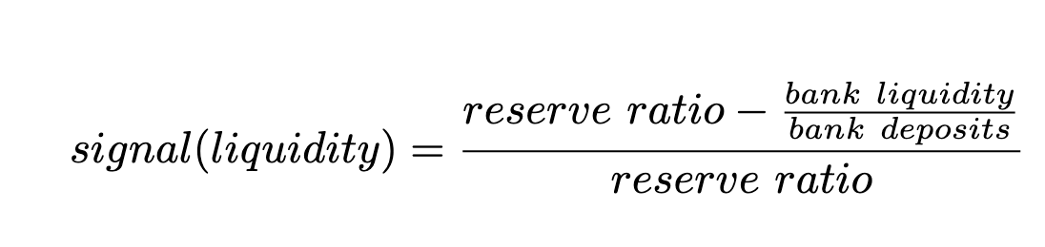
03 MODELL-SETUP
update-signal
signal
liquidity
Notes:
relative Unterschreitung der liquiditätsquote

Slide 12
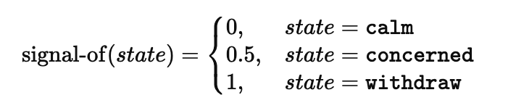
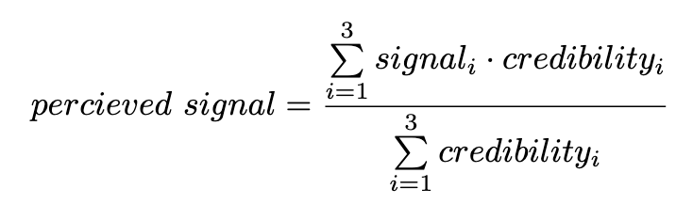
03 MODELL-SETUP
agents-decide
Signal
withdraw
Threshold Withdraw
to-report perceived-signal
end
Signal
concerned
Threshold concerned
calm
Signal
Notes:
MIAU

Slide 13

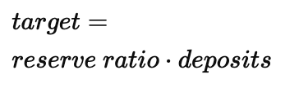
03 MODELL-SETUP
bank-manage-liquidity
with Lender of Last Resort
borrow
liquidity
borrow
if lolr-active? and bank-liquidity < target [
let need target - bank-liquidity ;; needed
let cap lolr-cap * initial-deposits ;; maximally allowed
let borrow min (list need cap) ;; borrow the allowed amount
set bank-liquidity bank-liquidity + borrow ;; add to liquidity
set bank-debt bank-debt + borrow ;; put it on as debt
]
liquidity
pay back

Slide 14
03 MODELL-SETUP
to go
if not bank-alive? [ stop ]
update-signal
baseline-noise
agents-decide
bank-manage-liquidity
recolor
tick
end
Notes:
baseline rauschen als täglicher Liquiditäts

Slide 15
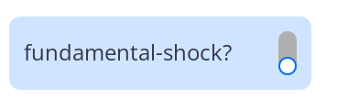
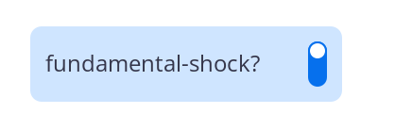
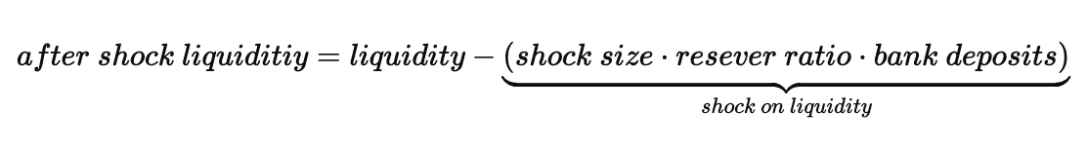

03 MODELL-SETUP
Shock

Slide 16
03 MODELL-SETUP
update-signal
signal
liquidity
Notes:
relative Unterschreitung der liquiditätsquote

Slide 17
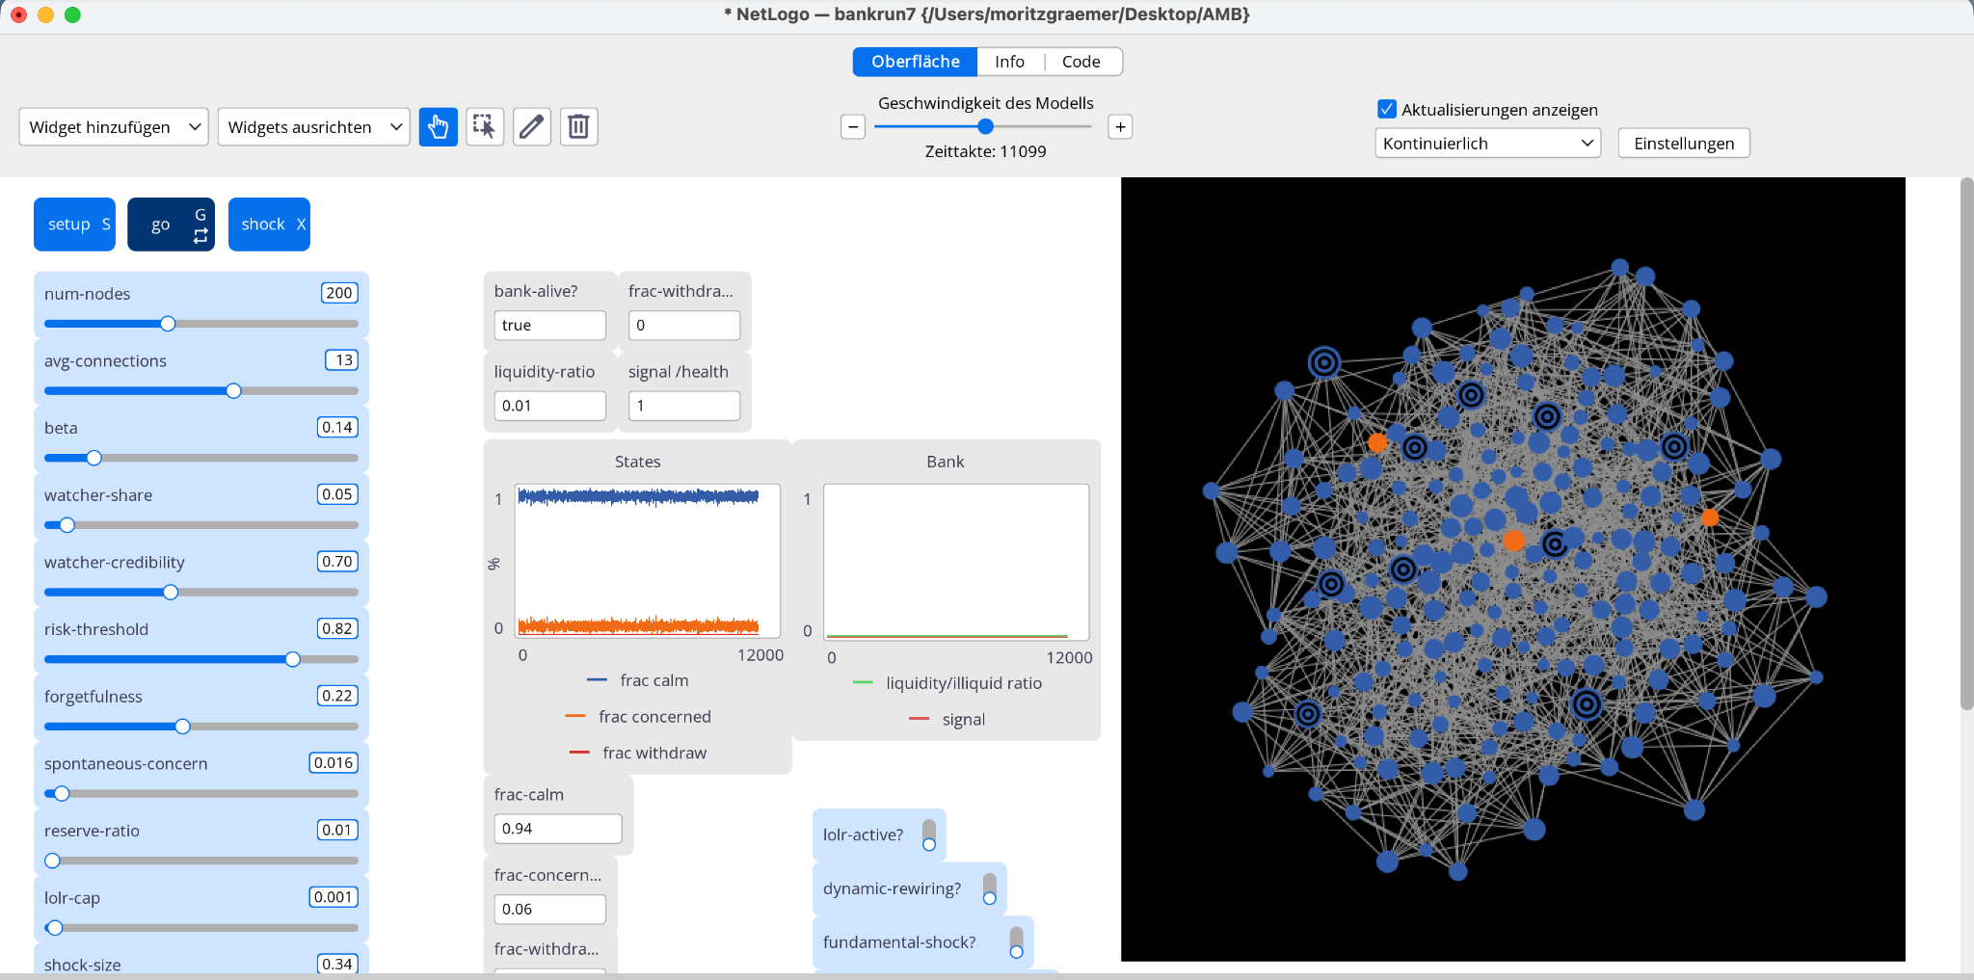

Slide 18
03 MODELL-SETUP
to go-exp
if not bank-alive? [ stop ]
if ticks = warmup-ticks [ shock ] ;; deterministic =0-shock
update-signal
baseline-noise
agents-decide
bank-manage-liquidity
if frac-withdrawn > peak-withdrawn [ set peak-withdrawn frac-withdrawn ]
recolor
tick
end
Notes:
baseline rauschen als täglicher Liquiditäts

Slide 19
04 Results
Behavioral Space
Parameters:
variables examined:
avg-connections (2 -> 20, step: 1)
fundamental-shock {false, true}
lolr-active? {false, true}
other variables constant

Slide 20
04 Results
Behavioral Space
Run 1:
reserve-ratio = (0.02, 0.04, 0.06); shock-size = 0.6; risk-threshold = 0.2; watcher-share = 0.05; repetitions = 50
Results: lethal instantly 95%-100% => not informative
Run 2:
reserve-ratio = (0.12, 0.16, 0.20); shock-size = 0.5; risk-threshold = 0.12; watcher-share = 0.20; repetitions = 50
Changes: watcher-share + reserve size => lethal through cascade
Results: clean, falling gradient over avg-connections; both shocks and Lolr

Slide 21
04 Results
Behavioral Space
Run 3:
reserve-ratio = (0.14, 0.16, 0.18); shock-size = 0.5; risk-threshold = 0.12; watcher-share = 0.20; repetitions = 100
Changes: centred around reserve-ratio of 0.16; repetitions doubled
Goal: centred, smooth transition, halved CI-width, cleaner variance

Slide 22
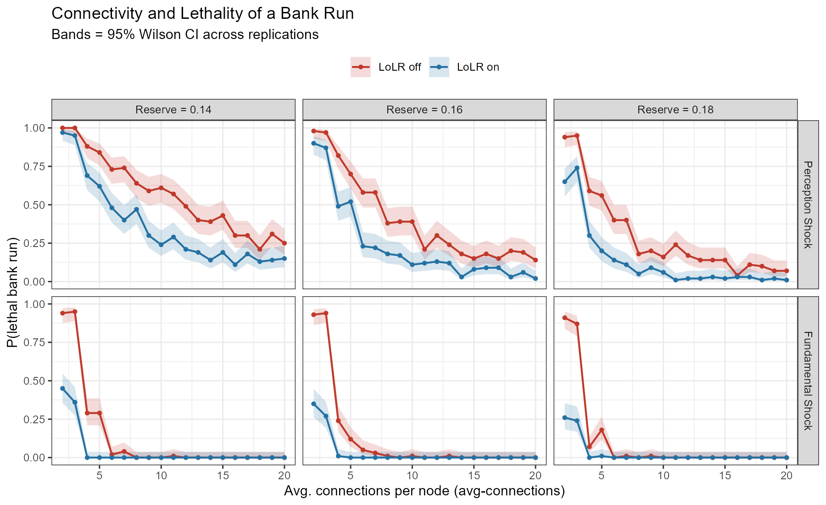
04 Results
Results

Slide 23
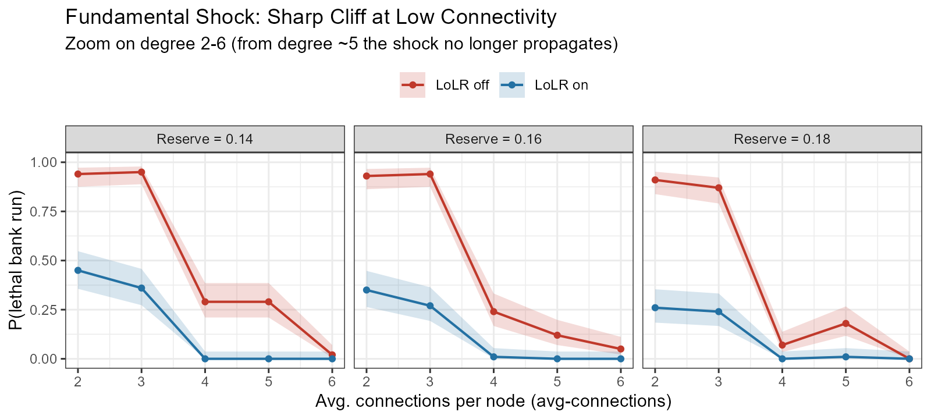
04 Results
Results

Slide 24
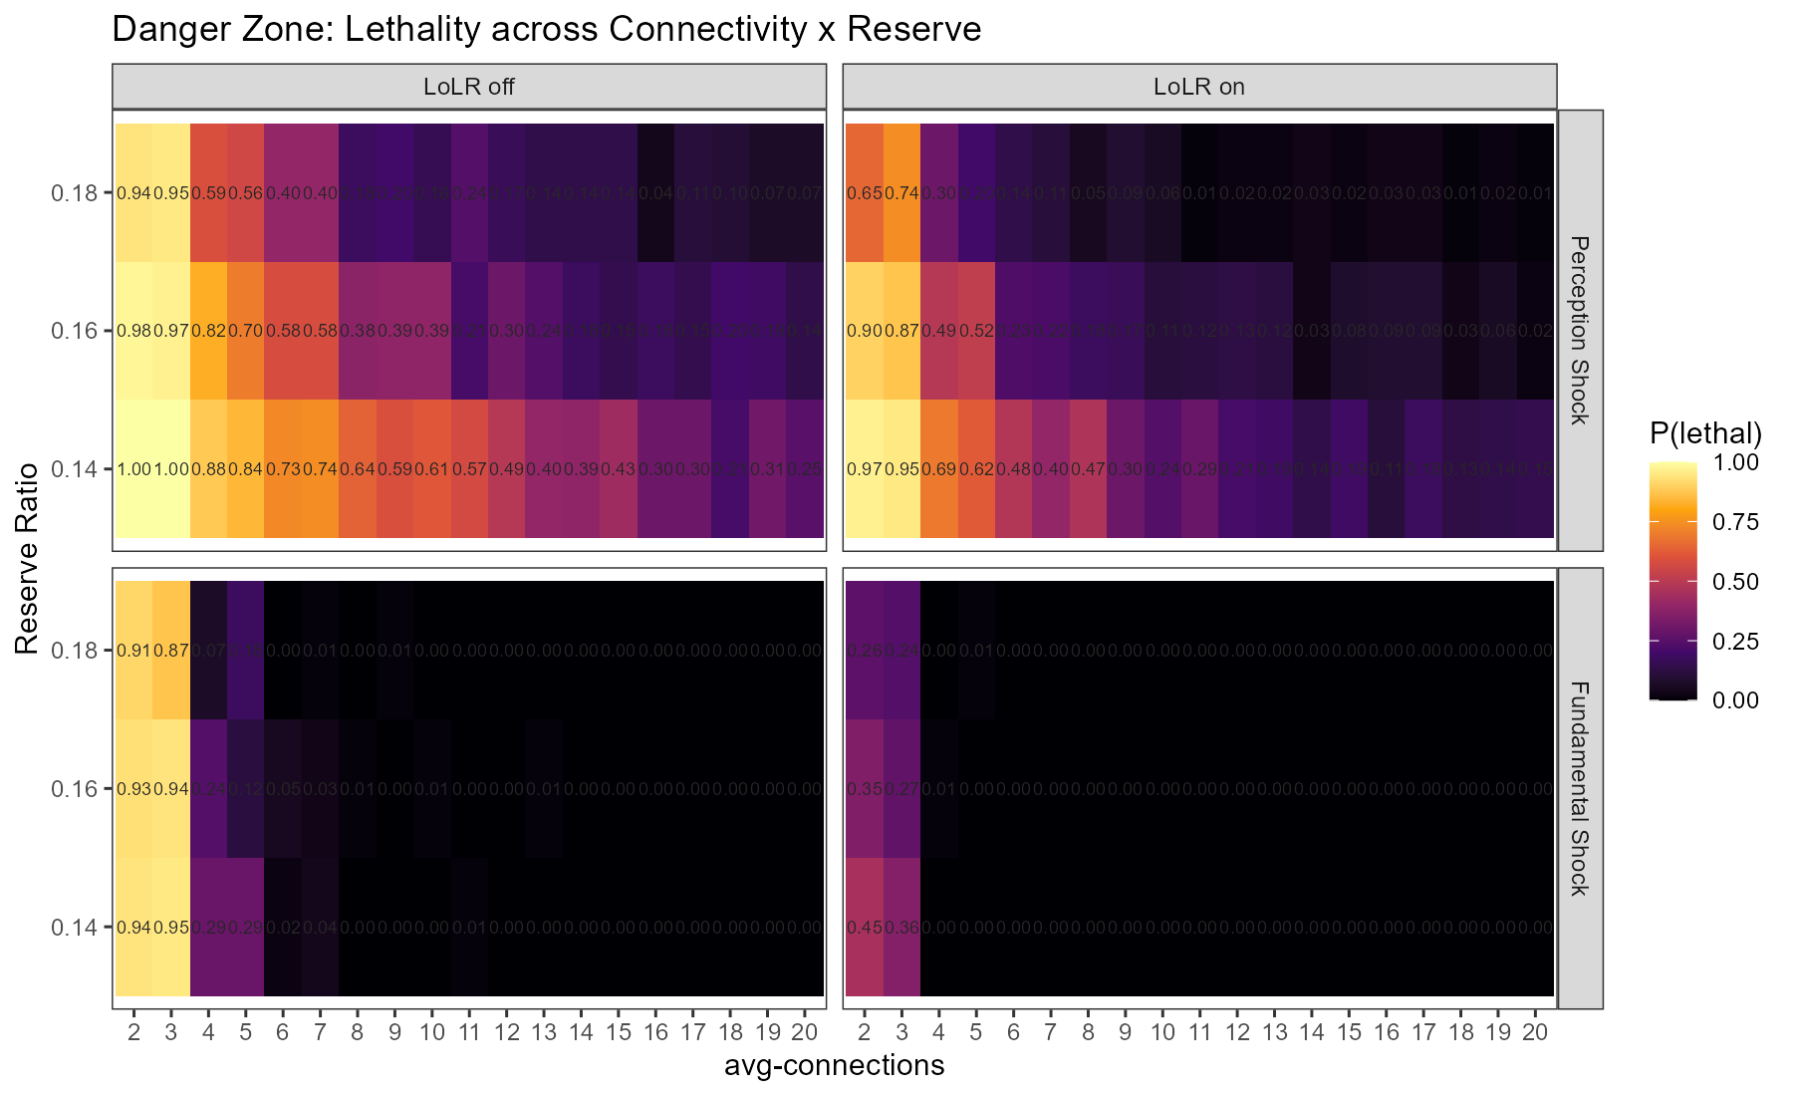
04 Results
Results

Slide 25
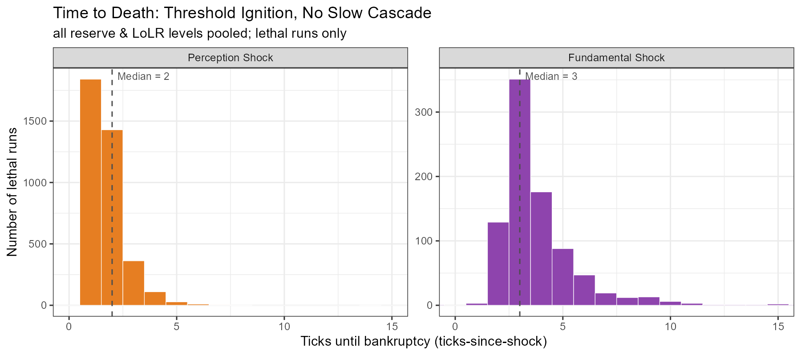
04 Results
Results

Slide 26
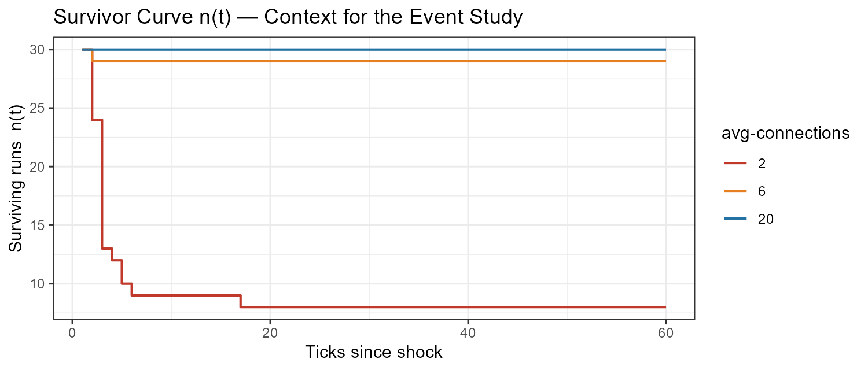
04 Results
Results
n=30

Slide 27
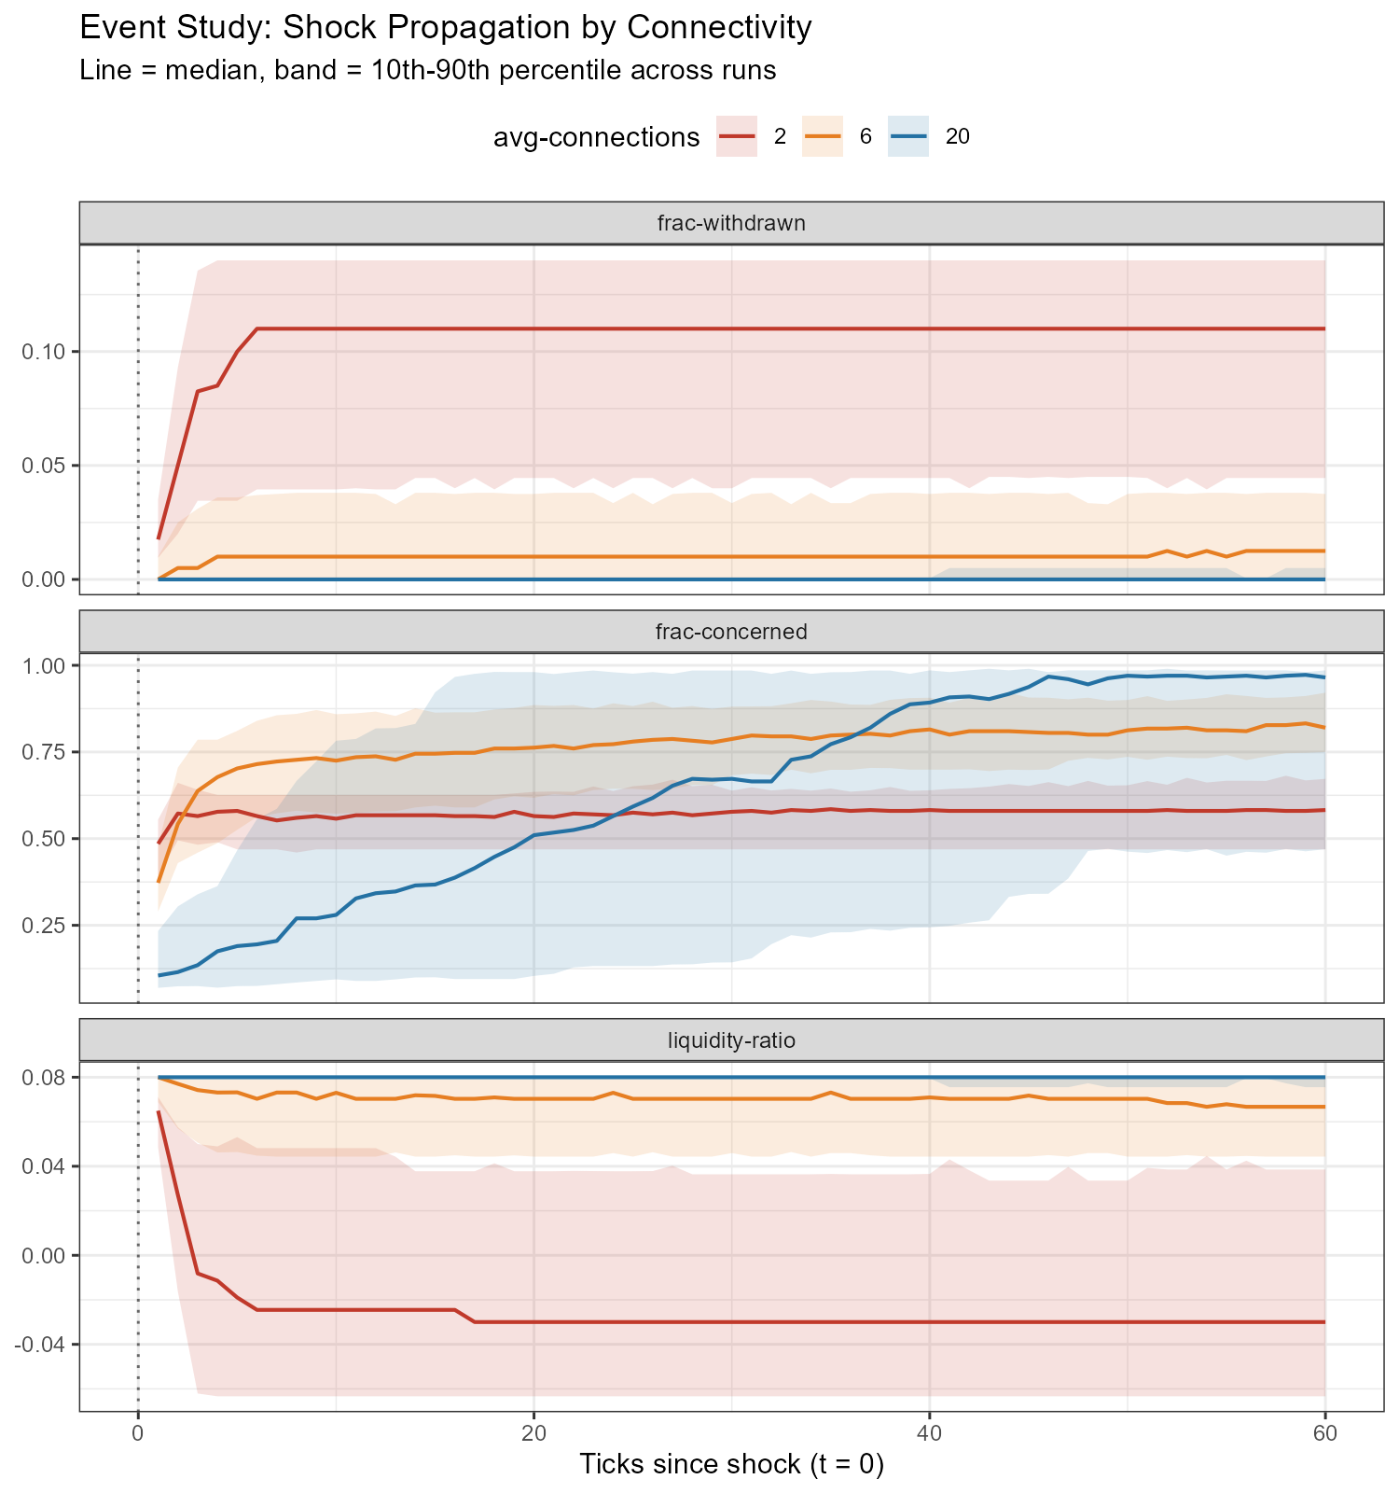
04 Results
Results
with fundamental shock

Slide 28
05 Sources
Sources
Deng, J., Yu, T., & Li, H. (2010). Bank runs in a local interaction model. Physics Procedia, 3(5), 1687–1697.
Diamond, D. W., & Dybvig, P. H. (1983). Bank runs, deposit insurance, and liquidity. Journal of Political Economy, 91(3), 401–419.
Elias, C. J. (2025). Bank runs via social networks. Journal of Economic Interaction and Coordination, 20, 1045–1066.
Huang, W., & Huang, Q. (2018). Connectionist agent-based learning in bank-run decision making. Chaos: An Interdisciplinary Journal of Nonlinear Science, 28(5), Article 055910.
Metrick, Andrew. 2024. "The Failure of Silicon Valley Bank and the Panic of 2023." Journal of Economic Perspectives 38 (1): 133–52.

Slide 29
05 Sources
Sources
Ruano, C., & Rajan, S. (2026). Social contagion and bank runs: An agent-based model with LLM depositors (arXiv:2602.15066).
Santos, T., & Nakane, M. I. (2021). Dynamic bank runs: An agent-based approach. Journal of Economic Interaction and Coordination, 16, 675–703.
Vanberg, C. (2026). Vorlesung: An introduction to agent-based modeling for economists . Alfred-Weber-Institut für Wirtschaftswissenschaften, Universität Heidelberg.
Wilensky, U. (1999). NetLogo user manual. Center for Connected Learning and Computer-Based Modeling, Northwestern University, Evanston, IL.

